Slide 1
PRESENTATION
ON
-:OBJECT DETECTION & RECOGNITION:-
SUBMITTED BY:-
SUBMITTED TO:-
MAYANK MISHRA (1718710061)
SATYENDDRA PANDEY (1718710094)
SHIVAM PANDEY(1718710099)
MR. SUNIL VERMA
HEAD OF DEPARTMENT
DEPT. OF COMPUTER SCIENCE & ENGINEERING

Slide 2
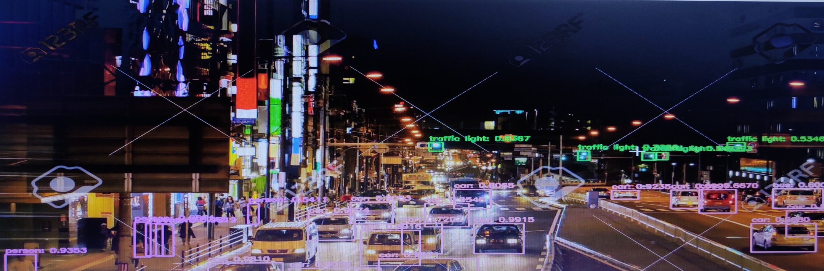
Object Detection
Object detection is a computer vision technique that allows us to identify and locate objects in an image or video. With this kind of identification and localization, object detection can be used to count objects in a scene and determine and track their precise locations, all while accurately labelling them.

Slide 3
Image Classification:
Predict the type or class of an object in an image.
Input: An image with a single object, such as a photograph.
Output: A class label (e.g. one or more integers that are mapped to class labels).
Object Localization:
Locate the presence of objects in an image and indicate their location with a
bounding box.
Input: An image with one or more objects, such as a photograph.
Output: One or more bounding boxes (e.g. defined by a point, width, and
height).
Object Detection: Locate the presence of objects with a bounding box and
types or classes of the located objects in an image.
Input: An image with one or more objects, such as a photograph.
Output: One or more bounding boxes (e.g. defined by a point, width, and
height), and a class label for each bounding box.

Slide 4
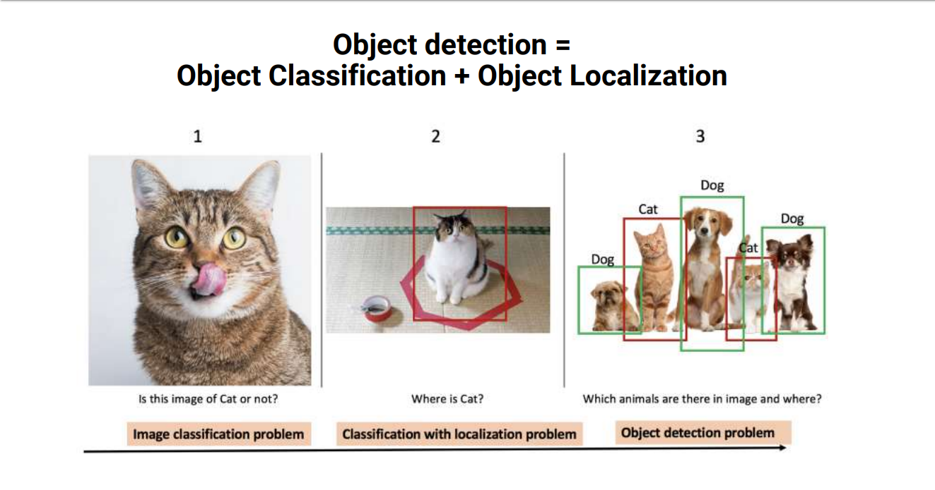

Slide 5
Object Recognition vs. Object Detection-
Object detection and object recognition are similar techniques for identifying objects, but they vary in their execution. Object detection is the process of finding instances of objects in images. In the case of deep learning, object detection is a subset of object Recognition, where the object is not only identified but also located in an image. This allows for multiple objects to be identified and located within the same image.

Slide 6
Why Deep learning for object detection?
Traditional object detection methods are built on handcrafted features and shallow trainable architectures. Their performance easily stagnates by constructing complex ensembles which combine multiple low-level image features with high-level context from object detectors and scene classifiers. With the rapid development in deep learning, more powerful tools, which are able to learn semantic, high-level, deeper features, are introduced to address the problems existing in traditional architectures. These models behave differently in network architecture, training strategy and optimization function, etc.

Slide 7
Appraches for Object Detection
Classical Approaches :-
Haar Feature
Histogram of Oriented Gradients (HOG) features
Deep Learning Approaches :-
R-CNN
Fast R-CNN
Faster R-CNN
You Only Look Once (YOLO)

Slide 8

Classical approach(Haar Feature)
A Haar-Feature is just like a kernel in CNN, except that in a CNN, the values of the kernel are determined by training, while a Haar-Feature is manually determined.
Haar-Features are good at detecting edges and lines. This makes it especial effective in face detection. For example, in a small image of Beyonce, this Haar-feature would be able to detect her eye (an area that is dark on top and brighter underneath)

Slide 9
Classical approach(Haar Feature)
However, because Haar Features have to be determined manually, there is a certain limit to the types of things it can detect. If you give classifier (a network, or any algorithm that detects faces) edge and line features, then it will only be able to detect objects with clear edges and lines. Even as a face detector, if we manipulate the face a bit (say, cover up the eyes with sunglasses, or tilt the head to a side), a Haar-based classifier may not be able to recognize the face. A convolutional kernel, on the other hand, has a higher degree of freedom (since it’s determined by training), and could be able to recognize partially covered faces (depending on the quality of the training data).
On the plus side, because we don’t need to train Haar-Features, we can create a classifier with a relatively small dataset.

Slide 10
Deep Learning Approach
R-CNN - The R-CNN method uses a process called selective search to find out the objects from the image. This algorithm generates a large number of regions and collectively works on them. These collections of regions are checked for having objects if they contain any object. The success of this method depends on the accuracy of the classification of objects. It is a Three stage approach: - Extract possible objects using a region proposal method (the most popular one being Selective Search). - Extract features from each region using a CNN. - Classify each region with SVMs.
Fast R-CNN - The Fast-RCNN method uses the structure of R-CNN along with the SPP-net (Spatial Pyramid Pooling) to make the slow R-CNN model faster. The Fast-RCNN uses the SPP-net to calculate the CNN representation for the whole image only once. The Fast-RCNN model also includes the bounding box regression along with the training process. This makes both the processes of localization and classification in a single process, making the process faster.
Faster R-CNN- The Faster-RCNN method is even faster than the Fast-RCNN. The Fast-RCNN was fast but the process of selective search and this process is replaced in Faster-RCNN by implementing RPN (Region Proposal Network). The RPN makes the process of selection faster by implementing a small convolutional network, which in turn, generates regions of interest. Along with RPN, this method also uses Anchor Boxes to handle the multiple aspect ratios and scale of objects. Faster-RCNN is one of the most accurate and efficient object detection algorithms.

Slide 11
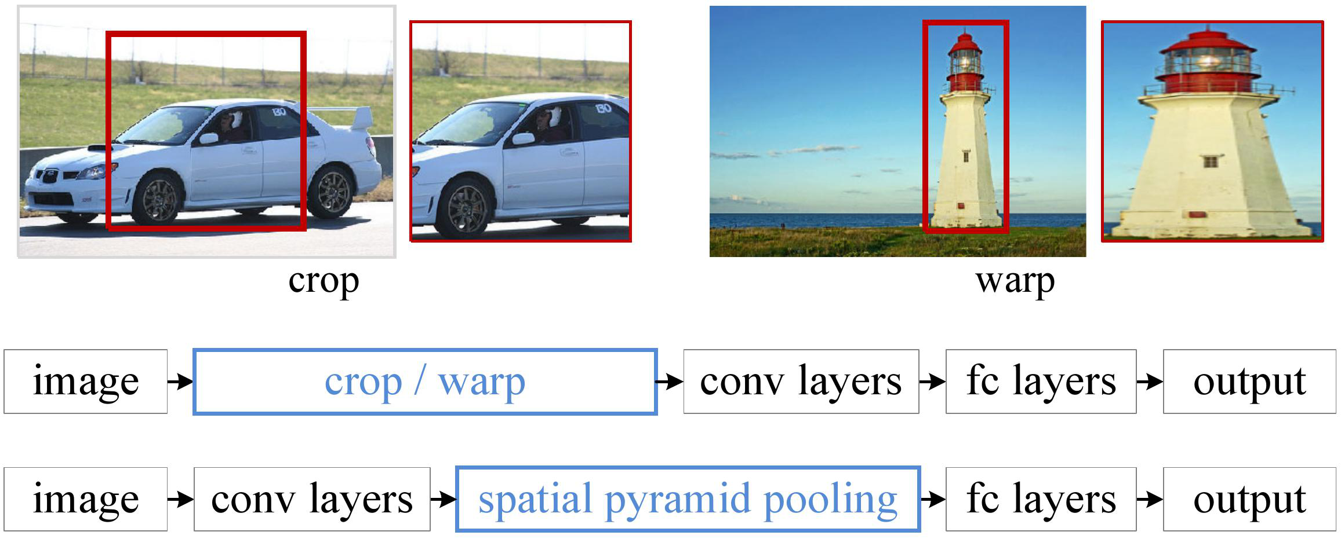

Slide 12
YOLO (YOU LOOK ONLY ONCE) MODEL
The R-CNN approach that we saw above focuses on the division of a visual into parts and focus on the parts that have a higher probability of containing an object, whereas the YOLO framework focuses on the entire image as a whole and predicts the bounding boxes, then calculates its class probabilities to label the boxes. The family of YOLO frameworks is very fast object detectors.
The different models of YOLO are discussed below:
YOLOv1
This model is also called the YOLO unified, for the reason that this model unifies the object detection and the classification model together as a single detection network. This was the first attempt to create a network that detects real-time objects very fast. YOLO only predicts a limited number of bounding boxes to achieve this goal.

Slide 13
YOLOv2 and v3
YOLOv2 and YOLOv3 are the enhanced versions of the YOLOv1 framework. YOLOv2 is also called YOLO9000. The YOLOv1 framework makes several localization errors, and YOLOv2 improves this by focusing on the recall and the localization. The YOLOv2 uses batch normalization, anchor boxes, high-resolution classifiers, fine-grained features, multi-level classifiers, and Darknet19. All these features make v2 better than v1. The Darknet19 feature extractor contains 19 convolutional layers, 5 max-pooling layers, and a softmax layer for the classification of objects that are present in the image.
The YOLOv3 method is the fastest and most accurate object detection method. It accurately classifies the objects by using logistic classifiers compared to the softmax approach used by YOLOv2. This makes us capable of making multi-label classifications. The YOLOv3 also uses Darknet53 as a feature extractor, which has 53 convolutional layers, more than the Darknet19 used by v2, and this makes it more accurate. It also uses a small object detector to detect all the small objects present in the image, which couldn’t be detected by using v1.

Slide 14
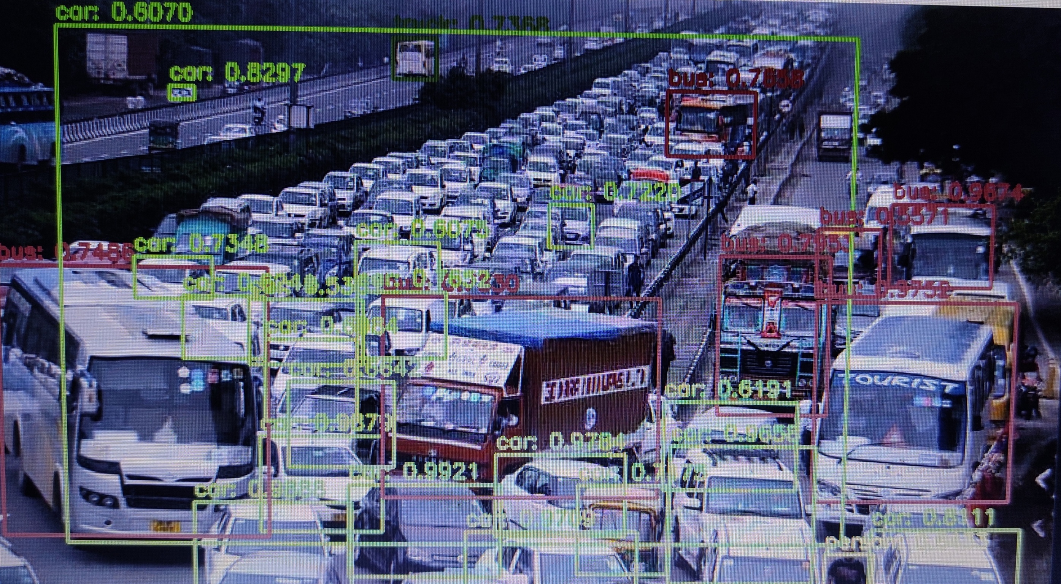
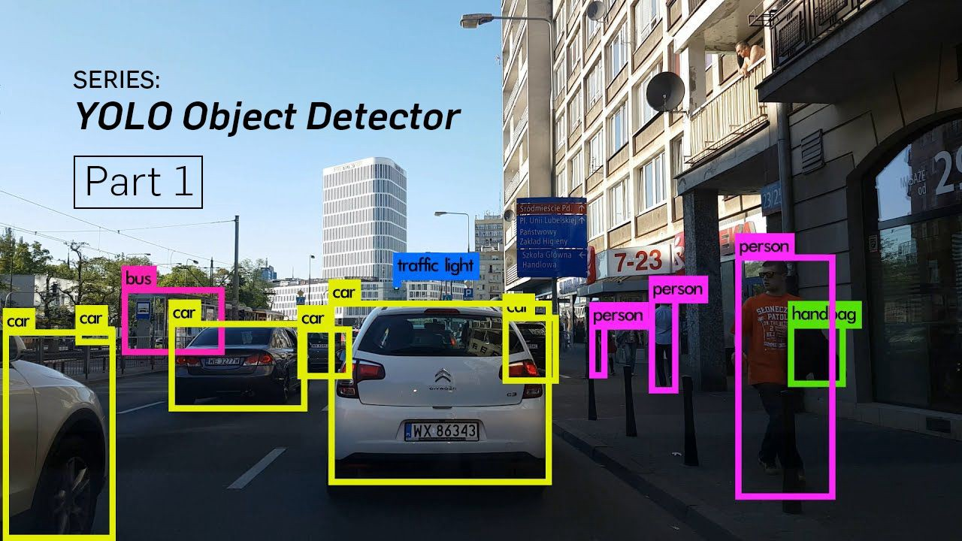

Slide 15
The YOLO model was first described by Joseph Redmon, in the 2015 paper titled “You Only Look Once: Unified, Real-Time Object Detection.” Note that Ross Girshick, developer of R-CNN, was also an author and contributor to this work, then at Facebook AI Research.
The approach involves a single neural network trained end to end that takes a photograph as input and predicts bounding boxes and class labels for each bounding box directly. The technique offers lower predictive accuracy (e.g. more localization errors), although operates at 45 frames per second and up to 155 frames per second for a speed-optimized version of the model.

Slide 16
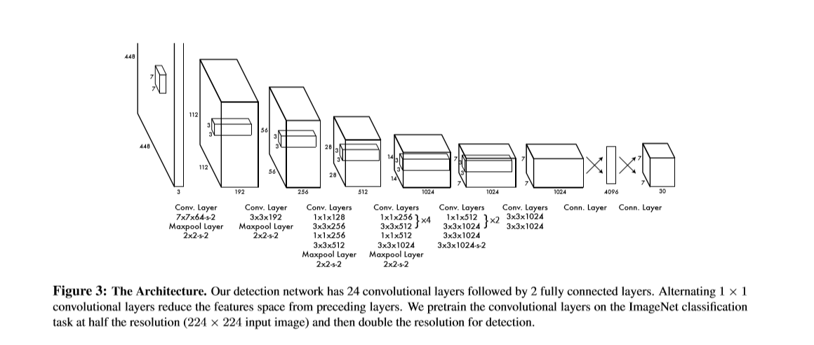
Network Design

Slide 17
PROCESS FLOW OF OBJECT DETECTION MODEL
The object detection process involves these steps to be followed:
Taking the visual as an input, either by an image or a video.
Divide the input visual into sections, or regions.
Take each section individually, and work on it as a single image
Passing these images into our Convolutional Neural Network (CNN) to classify them into possible classes.
After the classification, we can combine all the images and generate the original input image, but also with the detected objects and their labels.

Slide 18
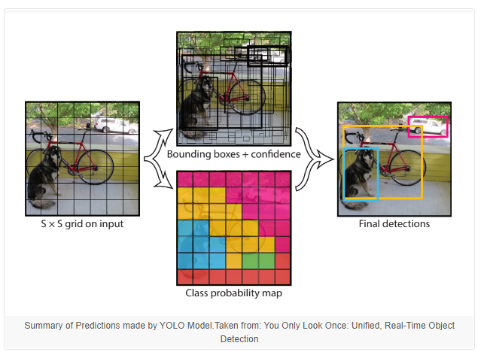
Working
The model works by first splitting the input image into a grid of cells, where each cell is responsible for predicting a bounding box if the center of a bounding box falls within it. Each grid cell predicts a bounding box involving the x, y coordinate and the width and height and the confidence. A class prediction is also based on each cell.
For example, an image may be divided into a 7×7 grid and each cell in the grid may predict 2 bounding boxes, resulting in 94 proposed bounding box predictions. The class probabilities map and the bounding boxes with confidences are then combined into a final set of bounding boxes and class labels. The image taken from the paper below summarizes the two outputs of the model.

Slide 19


Slide 20

Technology used-
Programming Language-
-Python
Tools –
- Command prompt
- Jupyter Notebook
Model-
R-CNN Model
Faster R-CNN Model
Fast R-CNN Model
YOLOv3- (You Look Only Once)

Slide 21

Python
Python is an interpreted, high-level, general-purpose programming language. Created by Guido van Rossum and first released in 1991, Python's design philosophy emphasizes code readability with its notable use of significant whitespace. Its language constructs and object-oriented approach aim to help programmers write clear, logical code for small and large-scale projects.
Python is dynamically typed and garbage-collected. It supports multiple programming paradigms, including structured (particularly, procedural), object-oriented, and functional programming. Python is often described as a "batteries included" language due to its comprehensive standard library.

Slide 22

Jupyter Notebook
The Jupyter Notebook is an open-source web application that allows you to create and share documents that contain live code, equations, visualizations and narrative text. Uses include: data cleaning and transformation, numerical simulation, statistical modeling, data visualization, machine learning, and much more.

Slide 23
System Requirement
Windows/Linux
RAM 4 GB or more
Python > 3.5.6
Numpy ==1.18.2
matplotlib==3.2.1
scikit-learn==0.23.1

Slide 24
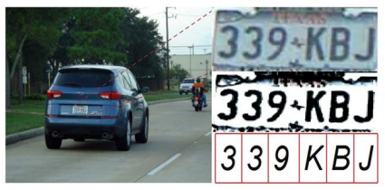
Application
1. Optical Character Recognition
Optical character recognition or optical character reader , often abbreviated as OCR, is the mechanical or electronic conversion of images of typed, handwritten or printed text into machine- encoded text, whether from a scanned document, a photo of a document, a scene-photo (for example the text on signs and billboards in a landscape photo) or from subtitle text superimposed on an image, we are extracting character from the image or video.

Slide 25
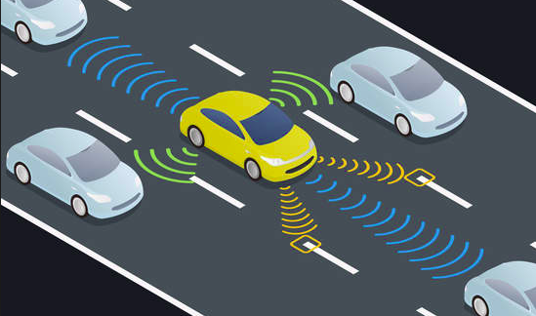
Application
2. Self Driving Car
One of the best examples of why you need object detection is for autonomous driving is In order for a car to decide what to do in next step whether accelerate, apply brakes or turn, it needs to know where all the objects are around the car and what those objects are That requires object detection and we would essentially train the car to detect known set of objects such as cars, pedestrians, traffic lights, road signs, bicycles, motorcycles, etc.

Slide 26

Application
3. Object Recognition as Image search
By Recognizing the objects in the images ,combining each object in the image and passing detected objects label in the URL we can make the object detection system as image search.

Slide 27
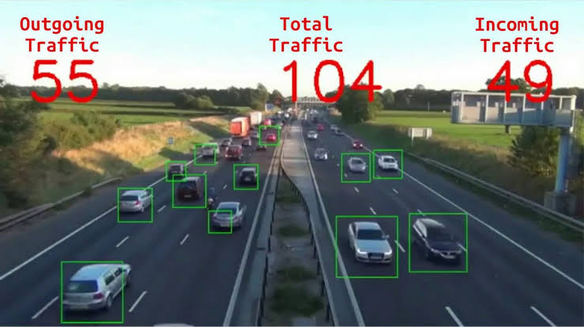
Application
4. Object Counting
Object detection system can also be used
for counting the number of objects in the
image or real time video. People Counting:
Object detection can be also used for people counting, it is used for analysing store performance or crowd statistics during
festivals. These tend to be more difficult
as people move out of the frame quickly
(also because people are non rigid objects).

Slide 28
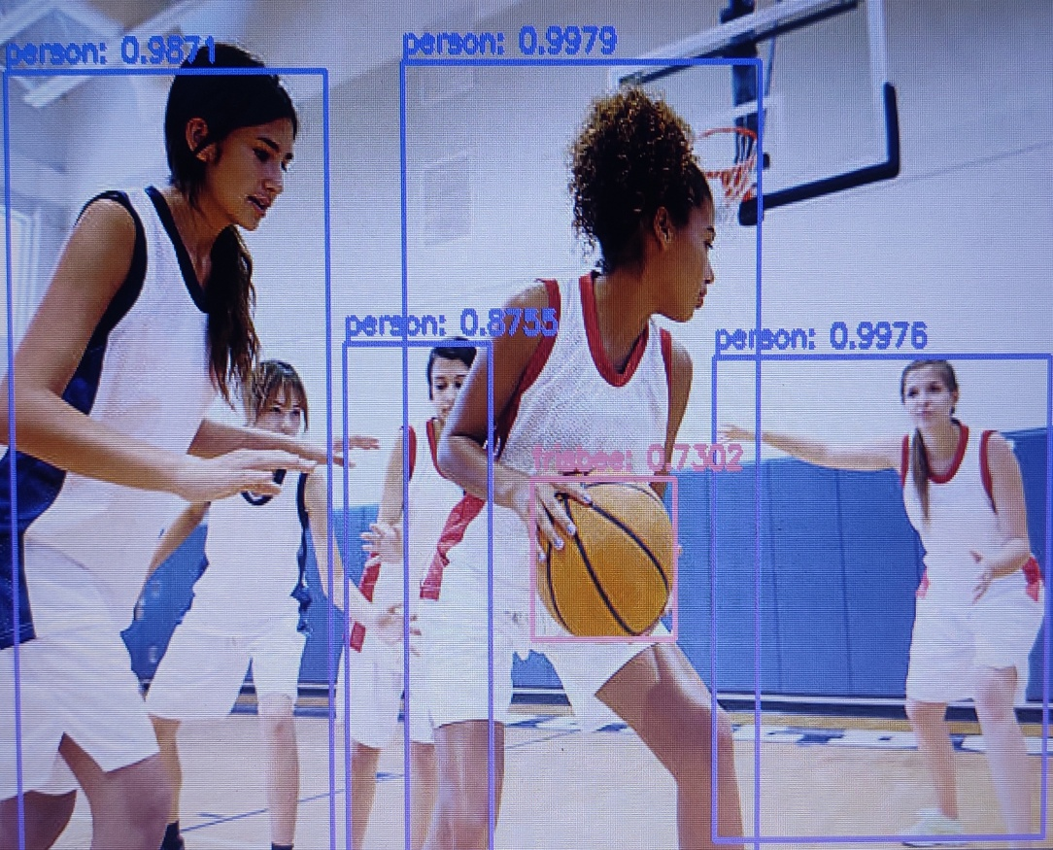
Application
5. Ball Tracking in Sports
Increase in the number of sport lovers in games like football, cricket, etc. has created a need for digging, analyzing and presenting more and more multidimensional information to them. Different classes of people require different kinds of information and this expands the space and scale of the required information. Tracking of ball movement is of utmost importance for extracting any information from the ball based sports video sequences and we can record the video frame according to the movement of the ball automatically.

Slide 29
Conclusion
An accurate and efficient object detection system has been developed which achieves comparable metrics with the existing state-of-the-art system. This project uses recent techniques in the field of computer vision and deep learning. Custom dataset was created using labelImg and the evaluation was consistent. This can be used in real-time applications which require object detection for pre-processing in their pipeline. An important scope would be to train the system on a video sequence for usage in tracking applications. Addition of a temporally consistent network would enable smooth detection and more optimal than per-frame detection.

Slide 30
THANK YOU

